Slide 1
Text Mining and Search
Agazzi Ruben 844736
Cominetti Fabrizio 882737

Slide 2
Project Details
00

Slide 3
Project Details
Tasks to be accomplished:
Text Classification
Text Clustering

Slide 4
Dataset
01

Slide 5
Dataset
The dataset used for the project is the IMDB Reviews dataset

Slide 6
Data Exploration
During this phase we observed that the dataset is composed by 50000 reviews, half positive and half negative.
The dataset is already divided in training and test set, each with 25000 reviews.

Slide 7
Classification The goal of the classification task is to distinguish between negative and positive reviews.
02

Slide 8
TEXT CLASSIFICATION
01
03
02
04
PROCESSING
CLASSIFICATION
Tokenization, stopwords, num, punct removal, lemmatization, case folding
Training of classifiers on the two obtained representations
TEXT REPRESENTATION
EVALUATION
Tf-Idf and Bag-of-Words
Performance evaluation of the classifiers

Slide 9
ALTERNATIVE
TEXT PROCESSING
During this phase, we made the following operations:
All the text was transformed in lowercase
Number removal
Punctuation removal
Stop words removal
Extra space removal
Tokenization, using nltk’s word tokenizer
Lemmatization, using wordnet lemmatizer

Slide 10
ALTERNATIVE
TEXT REPRESENTATION
In order to train the classifiers, we needed to get a numerical representation of the text. We chose the following text representations:
Bag-of-Words: we considered uni-grams, bi-grams, and tri-grams. The final vectorized text is composed of 10000 features;
Tf-Idf: we considered uni-grams, bi-grams, and tri-grams, and the final vectorized text is composed by 10000 features.
Notes:
Bag-of-words and tf-idf are two popular text representation techniques used in text classification tasks. Here are some reasons why they are commonly used:
Bag-of-words is a simple and effective approach for text representation that involves counting the frequency of words in a document. It considers only the presence and frequency of words in a document and disregards the order in which they appear. This makes it a good choice for tasks that don't require understanding the meaning of the text, such as sentiment analysis.
Tf-idf is a more advanced approach that considers not only the frequency of words in a document, but also their importance in the corpus as a whole. It calculates a weight for each word that is proportional to its frequency in the document, but inversely proportional to its frequency in the corpus. This helps to identify words that are important for a document, but not necessarily common in the corpus as a whole. Tf-idf is particularly useful for tasks that require a deeper understanding of the text, such as topic classification or text clustering.
Efficiency: both bag-of-words and tf-idf are computationally efficient and can handle large volumes of text data. This is important for text classification tasks, as the amount of data can be vast and processing speed is critical for real-time applications.
Interpretability: both techniques produce text representations that are easy to interpret and understand. This is especially useful for applications where the results need to be understood and analyzed by human users.
Widely used: bag-of-words and tf-idf are widely used in the natural language processing (NLP) community and there are many libraries and tools available that support them. This makes it easy to use them in different text classification applications, and to compare results across different approaches and models.
In summary, including bi-grams and tri-grams in addition to uni-grams in text representation can lead to improved accuracy, reduced sparsity, and more context-aware text processing. However, the choice of n-gram types depends on the specific requirements of the task and the nature of the corpus being analyzed.

Slide 11
ALTERNATIVE
TEXT CLASSIFICATION
We chose to train three different classifiers:
Support Vector Machine (SVM)
Multi-Layer Perceptron (MLP)
Logistic Regression (LR)
Notes:
SVMs (Support Vector Machines), MLP (Multi-Layer Perceptron), and Logistic Regression are all popular models for sentiment text classification tasks. Here are some reasons why each of these models may be a good choice:
SVMs are often used in text classification tasks because they are effective at handling high-dimensional data and can find complex decision boundaries. SVMs also have a strong theoretical foundation, which makes them more interpretable than some other models. In addition, SVMs can handle imbalanced datasets, which is important in sentiment analysis where the classes may not be evenly distributed.
MLPs are neural networks with multiple layers of neurons and are often used in text classification tasks because they are capable of learning complex non-linear relationships between features. MLPs have been shown to be effective at sentiment analysis because they can automatically learn features that are most relevant to the classification task. MLPs can also handle both continuous and categorical inputs, which makes them a flexible choice for text classification.
Logistic Regression is a simple yet effective model for binary classification tasks such as sentiment analysis. Logistic Regression models are easy to interpret and can handle high-dimensional data efficiently. They are also robust to noise in the input data and can be regularized to prevent overfitting.
In addition to these reasons, all three models have been shown to perform well on sentiment analysis tasks in various studies and competitions. The choice of model ultimately depends on the specific requirements of the task, the size and quality of the data, and the computational resources available. In practice, it is often a good idea to compare the performance of multiple models and choose the one that works best for the specific task at hand.

Slide 12
ALTERNATIVE
Support Vector Machine
We trained a Support Vector Machine on both Bag-of-Words and Tf-Idf text representation.
After a process of trial and error, we used the SVM provided by the scikit-learn library (Linear SVC) with C parameter, which is a regularization parameter, equal to 0.001.
Class | Precision | Recall | F1-Measure
Negative | 0.87 | 0.86 | 0.87
Positive | 0.86 | 0.87 | 0.87
Accuracy |  |  | 0.87
Class | Precision | Recall | F1-Measure
Negative | 0.82 | 0.79 | 0.80
Positive | 0.79 | 0.83 | 0.81
Accuracy |  |  | 0.81
Trained using Bag of Words
Trained using Tf-Idf
Notes:
In scikit-learn, the C parameter in SVM (Support Vector Machine) is a regularization parameter that controls the trade-off between maximizing the margin and minimizing the classification error. In other words, the C parameter determines the cost of misclassifying data points.
A smaller value of C will lead to a larger margin between the classes, but may also result in more misclassifications. On the other hand, a larger value of C will lead to a smaller margin and fewer misclassifications.

Slide 13
ALTERNATIVE
Multi Layer Perceptron
We trained a Multi-Layer Perceptron on both Bag-of-Words and Tf-Idf text representation.
The network architecture is composed by 3 fully-connected layers with ReLU activation, the layers have 128, 64 and 32 neurons; and an output layer with sigmoid activation function with 1 neuron. We chose binary cross-entropy as loss function and adam as optimizer.
Class | Precision | Recall | F1-Measure
Negative | 0.87 | 0.79 | 0.83
Positive | 0.81 | 0.88 | 0.84
Accuracy |  |  | 0.83
Class | Precision | Recall | F1-Measure
Negative | 0.85 | 0.81 | 0.83
Positive | 0.82 | 0.86 | 0.84
Accuracy |  |  | 0.83
Trained using Bag of Words
Trained using Tf-Idf
Notes:
MLP (Multi-Layer Perceptron) is a type of artificial neural network that is commonly used for sentiment text classification. It consists of multiple layers of neurons, each connected to the next layer through weighted connections. The input layer receives the feature vector representing the text data, and the output layer produces the predicted sentiment class label.
During training, the weights of the MLP model are adjusted to minimize the prediction error on the training data. This is typically done using backpropagation, which involves propagating the error from the output layer back through the network and adjusting the weights accordingly.
The hyperparameters of the model, such as the number of hidden layers and the number of neurons in each layer, need to be carefully tuned to achieve the best performance on the specific dataset.
The ReLU (Rectified Linear Unit) activation function is a commonly used non-linear activation function in MLP (Multi-Layer Perceptron) models for sentiment text classification. The ReLU activation function is defined as follows: ReLU(x) = max(0, x). In other words, the ReLU function returns 0 for negative inputs, and the input value itself for non-negative inputs. This results in a simple and computationally efficient activation function that introduces non-linearity to the MLP model.

Slide 14
ALTERNATIVE
Logistic Regression
We finally trained a Logistic Regression classifier on both Bag-of-Words and Tf-Idf text representation.
After a process of trial and error we choose the l2 norm as penalty, a C (regularization parameter) with a value of 1 and we specified a limit of 500 iterations for the training.
Class | Precision | Recall | F1-Measure
Negative | 0.85 | 0.87 | 0.86
Positive | 0.87 | 0.84 | 0.85
Accuracy |  |  | 0.86
Class | Precision | Recall | F1-Measure
Negative | 0.87 | 0.87 | 0.87
Positive | 0.87 | 0.87 | 0.87
Accuracy |  |  | 0.87
Trained using Bag of Words
Trained using Tf-Idf
Notes:
In logistic regression, the L2 norm and the C parameter are both regularization techniques used to prevent overfitting and improve the performance of the model in sentiment text classification.
The L2 norm regularization, also known as ridge regression, adds a penalty term to the loss function of the logistic regression model that is proportional to the square of the L2 norm of the model's coefficients. This penalty term encourages the model to have smaller coefficients, which in turn can help to reduce overfitting by preventing the model from becoming too complex.
The C parameter, on the other hand, controls the inverse of the regularization strength in logistic regression. A smaller value of C corresponds to a stronger regularization, which results in smaller coefficients and a simpler model. A larger value of C corresponds to weaker regularization, which allows the model to fit the training data more closely and may result in overfitting.

Slide 15
ALTERNATIVE
EVALUATION
After seeing the classification results, we can state that all the three models performs very well, with all the values of accuracy higher than 80% in the binary classification task.
In particular, the best models, in terms of accuracy, are the Logistic Regression trained on Tf-Idf weights and the Support Vector Machine trained on Bag-of-Words.

Slide 16
Clustering The goal of the clustering task is to group together similar reviews.
03

Slide 17
CLUSTERING
01
03
02
04
PROCESSING
CLUSTERING
Tokenization, stopwords, num, punct removal, lemmatization, case folding
Find clusters using obtained text representation
TEXT REPRESENTATION
EVALUATION
Tf-Idf weights and dimensionality reduction
Performance evaluation of the clustering algorithms

Slide 18
ALTERNATIVE
PROCESSING
During this phase, we made the following operations:
All the text is transformed in lowercase
Number removal
Punctuation removal
Stop words removal
Extra space removal
Tokenization, using nltk’s word tokenizer
Lemmatization, using wordnet lemmatizer

Slide 19
ALTERNATIVE
TEXT REPRESENTATION
In order to perform the clustering steps, we needed to get a numerical representation of the text.
The next steps were followed to obtain the desired text representation:
Tf-Idf: we considered uni-grams and bi-grams, and the final vectorized text is composed by 10000 features;
SVD: we performed Singular Value Decomposition in order to obtain shorter and denser vectors that represent text. After SVD was performed, all vectors had a length of 200.

Slide 20
ALTERNATIVE
TEXT CLUSTERING
We used the following clustering algorithms:
DBSCAN: a partitional, partial and exclusive clustering algorithm. It creates clusters selecting dense regions of points. It is not needed to specify the number of clusters;
K-Means: a partitional, total and exclusive clustering algorithm. It assigns points to clusters based on their Euclidean distance. It is needed to specify the number of clusters.

Slide 21
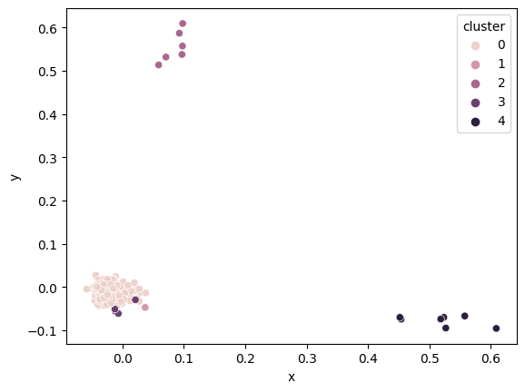
ALTERNATIVE
DBSCAN
We performed text clustering using the DBSCAN algorithm. In particular, we set the
Minimum distance between two points that are in the same cluster equal to 0.225 and we set the minimum number of elements per cluster equal to 5.
5 clusters were found, and 247 reviews were assigned to a cluster.
Silhouette coefficient = 0.391
Plot of the clusters (points not assigned to any clusters are omitted)

Slide 22
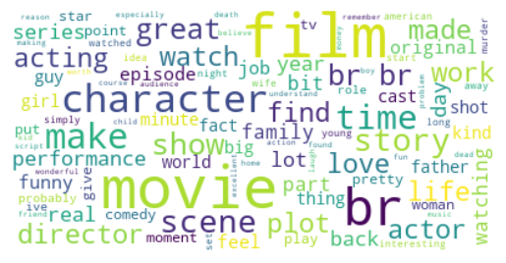
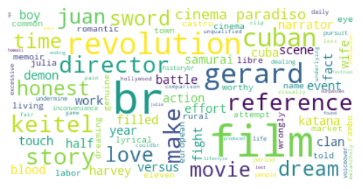
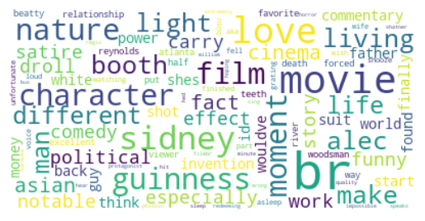
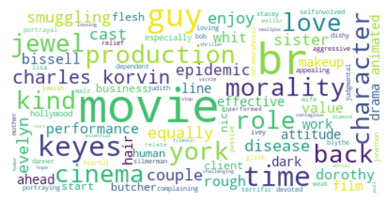
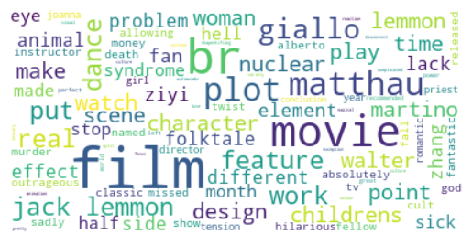
DBSCAN Clusters WordClouds
ALTERNATIVE
Notes:
Love-stories
Action
Comedy
Drama
Mix

Slide 23
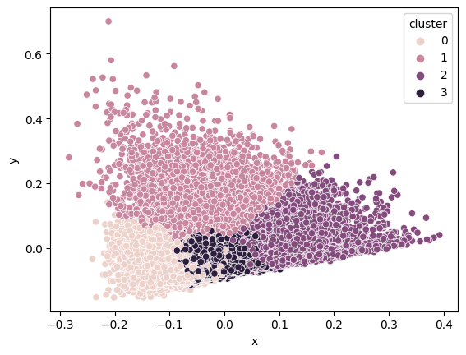
ALTERNATIVE
K-Means
We performed text clustering using the K-Means algorithm. In particular, we set the number of clusters equal to 4. The silhouette measure was equal to 0.017
Silhouette coefficient = 0.017
Plot of the clusters

Slide 24
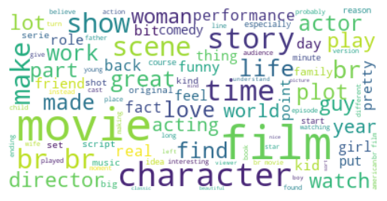
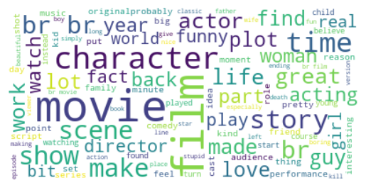
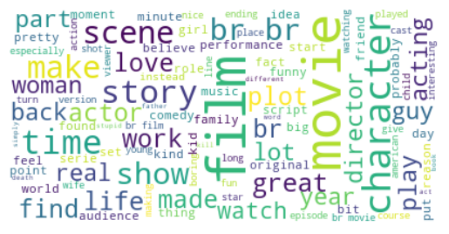
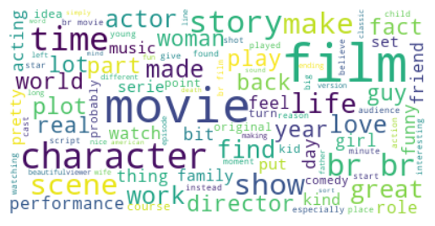
K-Means Clusters WordClouds
ALTERNATIVE
Notes:
Non riconoscibili, ad esempio comedy presente in tutti.

Slide 25
ALTERNATIVE
EVALUATION
As we can see from the average Silhouette measure, the clustering algorithm that performs “better” is the DBSCAN, even though only 300 reviews out of 50000 are assigned to a cluster. In the other hand, the k-means algorithm have a lower average Silhouette but all the reviews are assigned to a cluster.

Slide 26
ALTERNATIVE
CONCLUSIONS
We can be satisfied with what we obtained from the text classification phase, with all three algorithms achieving a good accuracy value.
Regarding text clustering, the Silhouette coefficient values obtained by the algorithms are not equally satisfactory.
Possible future developments could include different algorithms and different text representation techniques.

Slide 27
THANK YOU!

